Slide 1
Cardiovascular Pathophysiologic conditions
Lecture 2

Slide 2
ANEURYSM
A localized abnormal dilation of a blood vessel, usually an artery. Common sites include the thoracic and abdominal aorta and vessels within the brain.
An aneurysm is an abnormal balloon-like bulge in the wall of a blood vessel. An aneurysm occurs when the wall of the blood vessel becomes weakened and can no longer tolerate the pressure of the blood, thus leading to bulging of the wall.
There are many factors which may lead to damage or weakening of the blood vessel walls, including smoking, high blood pressure, atherosclerosis, infections, genetic conditions, trauma, and advanced age.

Slide 3
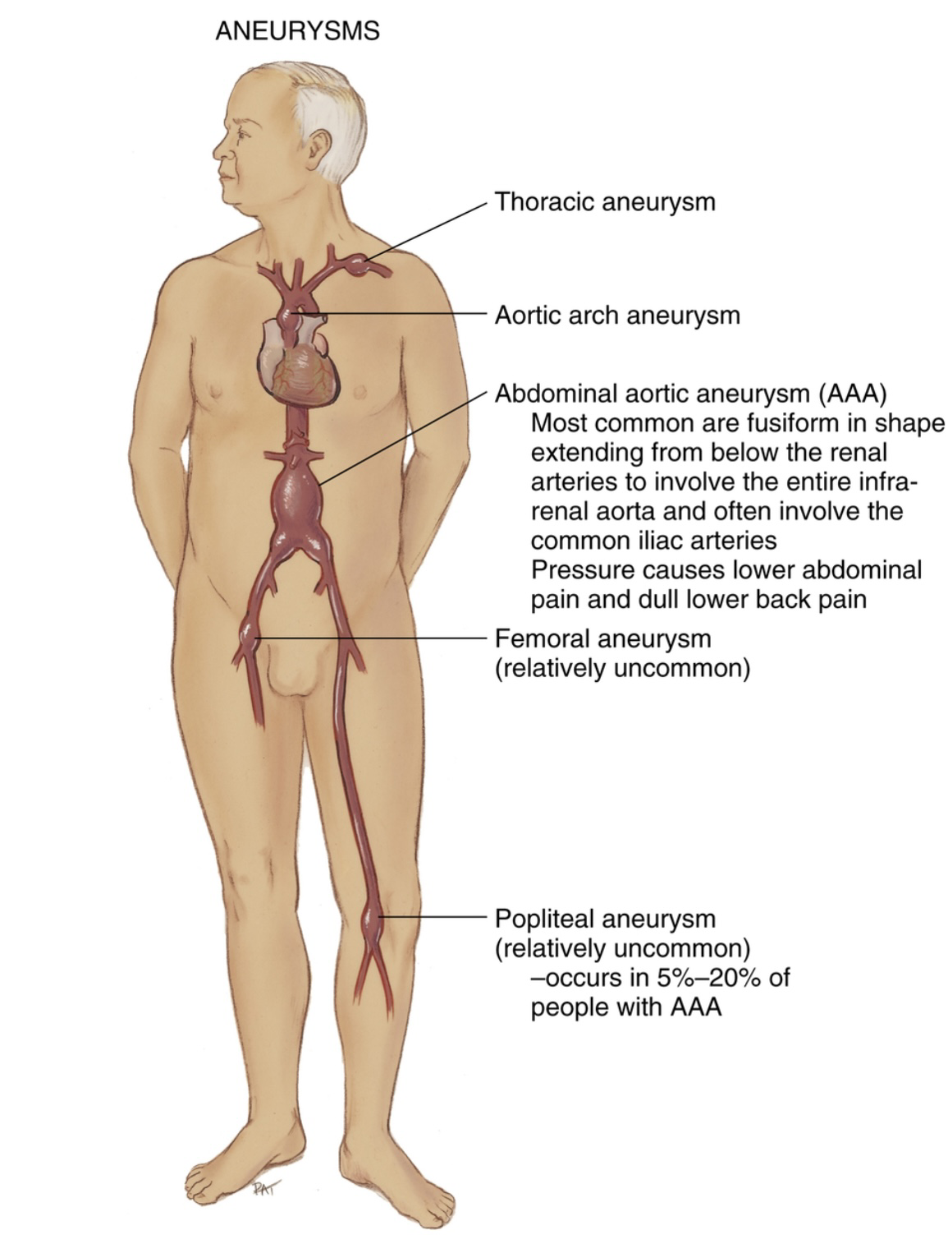

Slide 4
Most aneurysms occur in the aorta, and are labeled thoracic aortic aneurysms (TAA) or abdominal aortic aneurysms(AAA) based on the portion of the aorta affected. Aneurysms also occur in the brain, specifically in the Circle of Willis circulation, or in any peripheral artery.
Symptoms of ruptured AAA include low back, abdominal or groin pain, nausea and vomiting, lightheadedness, and a rapid heart rate. The internal bleeding from a ruptured AAA will typically lead to hypovolemic shock (liquid portion of blood is too low) and is fatal in the large majority of cases.
Symptoms of a TAA include jaw, neck, back or chest pain, coughing and shortness of breath.
A brain aneurysm may cause fatigue, loss of balance, and speech and vision problems. A ruptured brain aneurysm will result in a subarachnoid hemorrhage. Symptoms may include severe headache, loss of vision or double vision, loss of consciousness, vomiting, change in mental status, and seizure. This is a medical emergency.

Slide 5
The imaging studies that may be performed to detect an aneurysm include ultrasound, computed tomography, magnetic resonance imaging, echocardiography, and angiography.
Treatment - Antihypertensive medications may be recommended for hypertension. Surgery is recommended to repair large aortic aneurysms and consists of replacing the aneurysm with a synthetic fabric graft.

Slide 6
ANGINA PECTORIS
Angina pectoris results from diminished myocardial perfusion, most commonly caused by narrowing of one or more of the coronary arteries (e.g., due to embolism, atherosclerosis, inflammation).
When the tissue's oxygen demand is greater than that provided by the coronary arteries, myocardial ischemia results in chest pain.
This specific type of pain is termed angina pectoris and is most commonly associated with underlying coronary artery disease (CAD).
Angina pectoris is not an independent disease process, but rather a symptom of myocardial ischemia.

Slide 7
Angina pectoris is typically described as an uncomfortable or painful feeling of tightness, pressure, fullness or squeezing in the center of the chest. Symptoms will typically present on the left side of the body in the back, arm, shoulder, neck or jaw when accompanied by radiating pain. Shortness of breath and unexplained fatigue are also frequently reported.
Angina pectoris may be classified as either stable or unstable.
Stable angina occurs predictably in response to activities that increase the oxygen demands of myocardial tissue (e.g., exercise, stress, cold weather, large meals). Stable angina symptoms typically do not last longer than 15 minutes and are relieved with rest or nitroglycerin.
Unstable angina is typically considered to be more serious since it occurs without cause and is often unresponsive to nitroglycerin.

Slide 8
A 12-lead electrocardiogram (ECG) is most commonly used to diagnose angina pectoris with an inverted T wave indicating myocardial ischemia.
Pharmacological intervention may target vessel relaxation, heart rate, the blood’s clotting ability or cholesterol levels. Aspirin, nitrates, beta-blockers, statins, calcium channel blockers, and ACE inhibitors may be used in the treatment of angina. The goal of surgical intervention is typically to widen a coronary artery in order to improve blood flow.
Angioplasty, stent placement, and coronary artery bypass graft are common surgical procedures. Lifestyle changes such as smoking cessation, weight management, increased activity level, and stress management are recommended.
Physical therapy intervention usually follows a multiphase cardiac rehabilitation program for patients with stable angina.

Slide 9
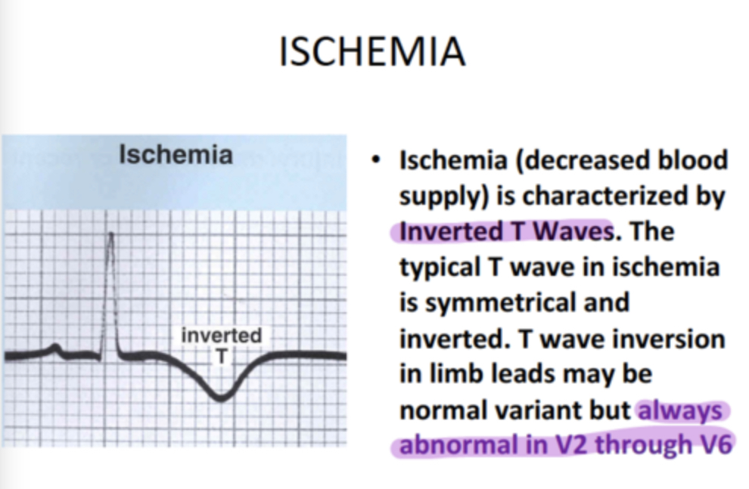

Slide 10
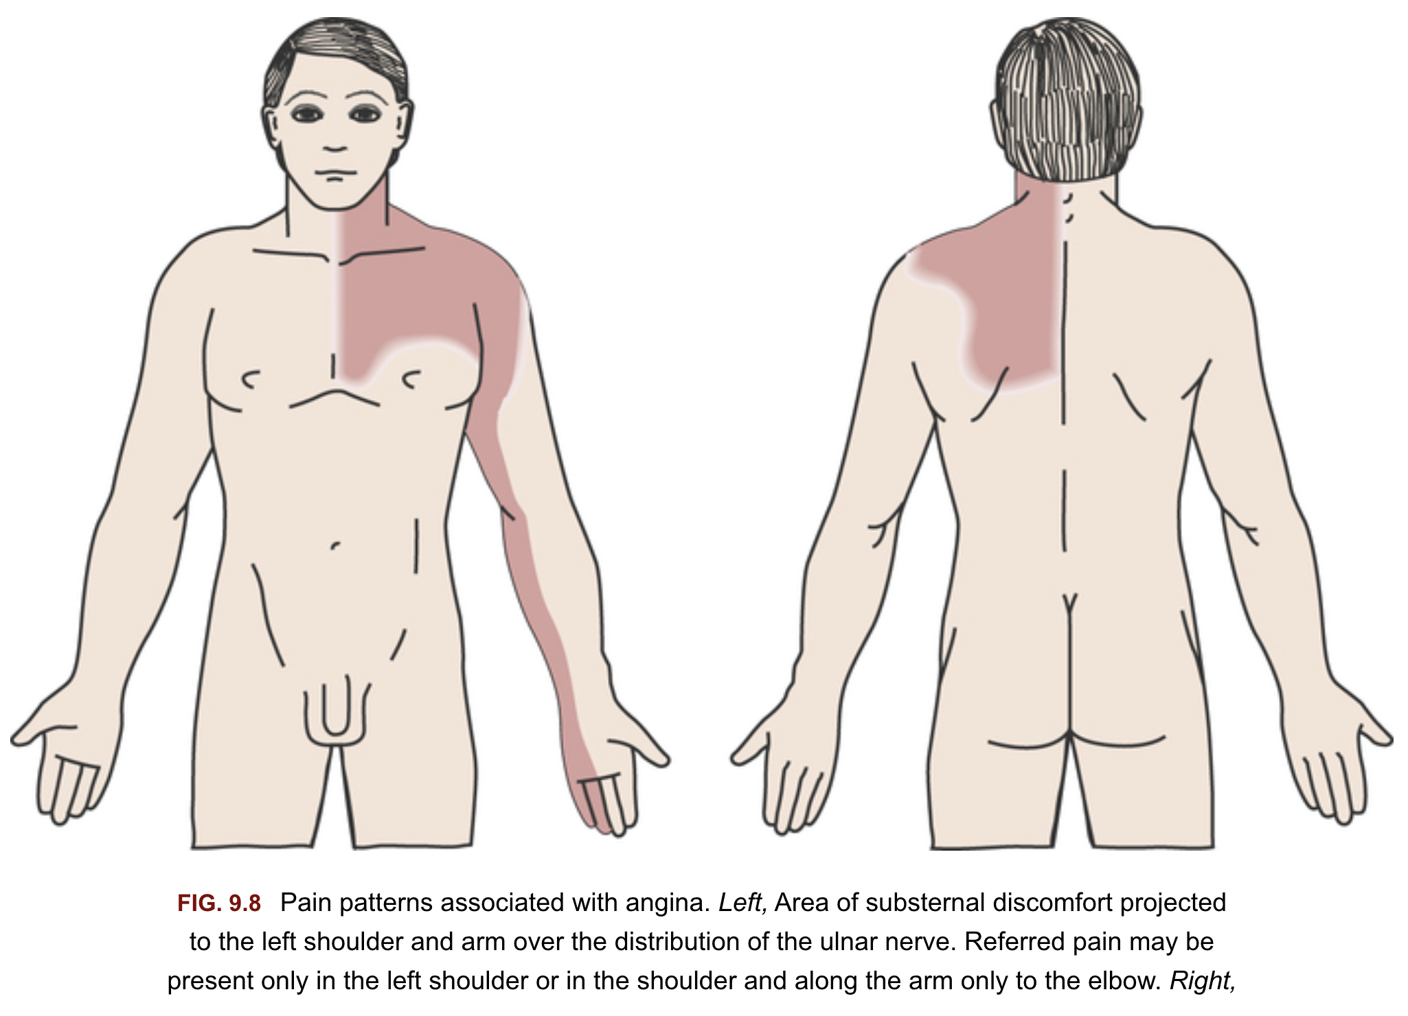

Slide 11
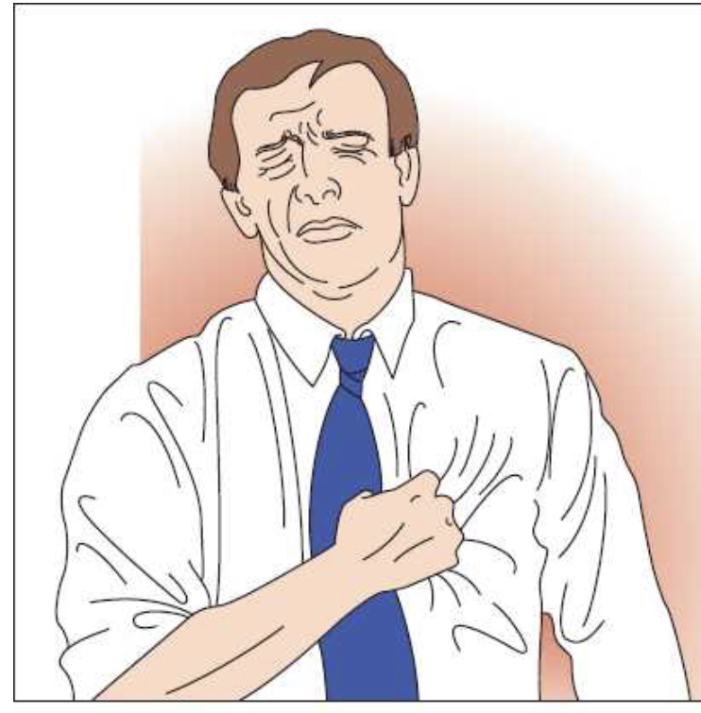
Levine's sign is a clenched fist held over the chest to describe ischemic chest pain. It is named for Samuel A. Levine (1891-1966), an influential American cardiologist, who first observed that many patients suffering from chest pain made this same sign to describe their symptoms. This clenched fist signal may be seen in patients with acute coronary syndrome (myocardial infarction and angina pectoris). A variant of this sign which uses the entire palm instead of the clenched fist over the chest is commonly known as the Palm Sign and in Latin America, it is widely referred to as the Cossio's Sign or Cossio-Levine Sign.

Slide 12
AORTIC ATHEROSCLEROSIS (athero-fatty substance; sclerosis- hardening)
Aortic atherosclerosis is a "silent" disease. Plaque builds up in the aorta with rarely any outward signs or symptoms.
Aortic atherosclerosis is found mostly in older men. After age 50, most people have some degree of atherosclerosis in the aorta.
Signs and Symptoms. Frequently no symptoms are associated with this problem. In the mild form of aortic atherosclerosis, there are fatty deposits with some fibrotic plaques and minimal atheromas (fatty material). Progression of the disease, however, may cause almost complete obliteration of the aorta due to massive deposition of atheromas.
A danger also exists that emboli will form from the atherosclerotic aorta. The aorta becomes rigid with calcification (aortic calcification), and has a very small lumen. At this stage, the aorta becomes unable to adjust to the normal changes in the cardiac cycle and, together with the small lumen of the aorta, causes hypertension.
Frequently an aneurysm develops in the aorta due to the pressure of blood from the heart.

Slide 13
Atherosclerosis and Arteriosclerosis
Atherosclerosis literally means hardening of the arteries.
Arteriosclerosis is hardening of the walls of the smaller arterial vessels, called arterioles, found in the extremities of the limbs and in body organs.
In both cases, it is the narrowing and thickening of the walls of the arteries/arterioles that causes a reduction of the lumen (the channel through the vessel).
The thickening of the vessel walls is accompanied by loss of elasticity, flexibility, and contractility.
This is largely due to deposition of fatty, cholesterol plaques on the interior wall of the artery.

Slide 14
Atherosclerosis is caused by changes in the walls of the arteries. Such changes can be due to high blood pressure over a prolonged period of time, diabetes, and cigarette smoking.
Because of the deposition of plaques, the arteries become narrowed, hardened, and inflexible with less ability to contract and relax in response to needs of the circulatory system. The plaques (atheromas) project into the lumen of the artery causing partial or total obstruction. The mechanism for development of the disease is complex and not fully understood.

Slide 15
Signs and symptoms -based on the severity of disease and the artery affected. When the coronary arteries are affected, angina pectoris may result. When cerebral arteries are affected, numbness or weakness of the arms or legs, difficulty speaking or slurred speech, or drooping face muscles may result. When peripheral arteries are affected, intermittent claudication may result.
The prognosis of atherosclerosis depends on many factors. If the sclerosis is situated in arteries that supply major organs such as the brain, heart, and lungs, there is the potential for a clot to form and interrupt blood supply to these organs, causing ischemia, severe injury, or death. If diagnosed early, medical and surgical procedures can be performed to improve the prognosis.

Slide 16
CORONARY ARTERY DISEASE (CAD)
Coronary artery disease (CAD) occurs as a result of atherosclerotic plaque buildup within the coronary arteries. The plaque is primarily comprised of fatty deposits containing cholesterol and other blood products that accumulate over time.
CAD typically develops slowly and often goes unnoticed for years before producing symptoms.
The right and left coronary arteries are branches of the ascending aorta. The right coronary artery primarily supplies the right atrium and ventricle and the left coronary artery primarily supplies the left atrium and ventricle.
As plaques develop, the arteries harden and narrow, decreasing the volume of blood available to perfuse cardiac tissue when demand is increased. Diminished perfusion significantly increases the risk of myocardial ischemia and permanent cardiac damage.

Slide 17
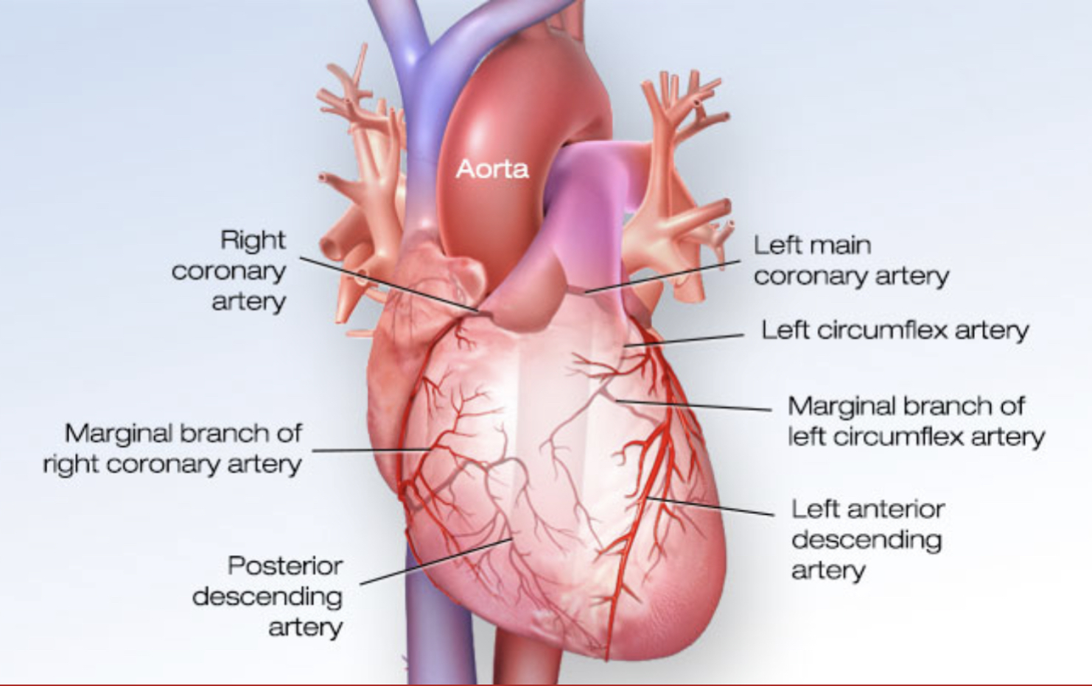

Slide 18
The risk factors for CAD include hypertension, diabetes, obesity, chronic kidney disease, elevated cholesterol and triglyceride levels, and family history. Modifiable risk factors include smoking, inactivity, alcohol abuse, and stress.
Certain patients with CAD never develop symptoms. In others, symptoms typically develop when arteries are no longer able to adequately perfuse cardiac tissue resulting in ischemia.
A partial occlusion may cause exertion-related shortness of breath, weakness or angina pectoris and is often the initial indicator of underlying pathology. In some cases, however, the first symptom of CAD may be as severe as a myocardial infarction secondary to plaques that have completely occluded an artery.

Slide 19
Cardiac catheterization with coronary angiography introduces contrast dye via small catheters into the coronary arteries for x-ray imaging. This invasive diagnostic procedure provides the most accurate information regarding both the location and severity of CAD. CT scan and magnetic resonance coronary angiograms provide a less invasive means of visualizing the coronary arteries with contrast dye introduced either intravenously or via injection.
Pharmacological agents facilitate vessel relaxation, modify heart rate or reduce the blood's clotting ability or cholesterol levels. Aspirin, nitrates, beta-blockers, statins, calcium channel blockers, and ACE inhibitors maybe used alone or in combination.
Surgical intervention is typically performed to widen one or more of the coronary arteries in order to improve blood flow. Angioplasty, stent placement, and coronary artery bypass are common surgical procedures.
Physical therapy intervention is typically provided through a formal multiphase cardiac rehabilitation program.

Slide 20
HYPERTENSION
Hypertension (HTN) is a condition in which blood pressure is persistently elevated.
Primary HTN occurs without an identifiable cause and typically develops slowly over time.
Secondary HTN occurs as a result of underlying pathology (e.g., pre-eclampsia, kidney disease, congenital vessel defects, atherosclerosis, stress) or as a side effect of certain medications.

Slide 21
Blood pressure measures represent the force of blood against interior arterial walls.
The systolic component represents the maximum pressure exerted as the heart contracts.
The diastolic component represents the minimum pressure exerted when the heart is at rest.
In patients with primary HTN, increased forces may cause damage to the arteries, increasing the risk of more serious comorbidities (simultaneous presence of 2 or more conditions) such as CVA or MI.
For patients with secondary HTN, structural injuries may also be linked to the specific underlying pathology.

Slide 22
Risk increases further with age. Certain conditions (pregnancy, diabetes, sleep apnea) and modifiable risk factors (obesity, sedentary lifestyle, stress, tobacco use, excessive alcohol use, excess dietary sodium) are also associated with HTN.
Hypertension is classified based on the degree of elevation:
Stage 1 hypertension SBP 130-139 DBP 80-89
Stage 2 hypertension SBP 140 DBP 90
Hypertensive crisis SBP 180 DBP 120
Both systolic and diastolic values are relevant, however, many patients over 50 years of age demonstrate significantly elevated systolic measures with normal diastolic findings. This is referred to as isolated systolic hypertension (ISH).
Patients do not typically report symptoms due to the slow onset of primary HTN.
Secondary HTN may present with or without symptoms depending on the specific etiology and how quickly the condition progresses. Symptoms may not be recognized until blood pressure becomes dangerously high producing a headache, confusion, visual changes, fatigue, arrhythmia or tinnitus.

Slide 23
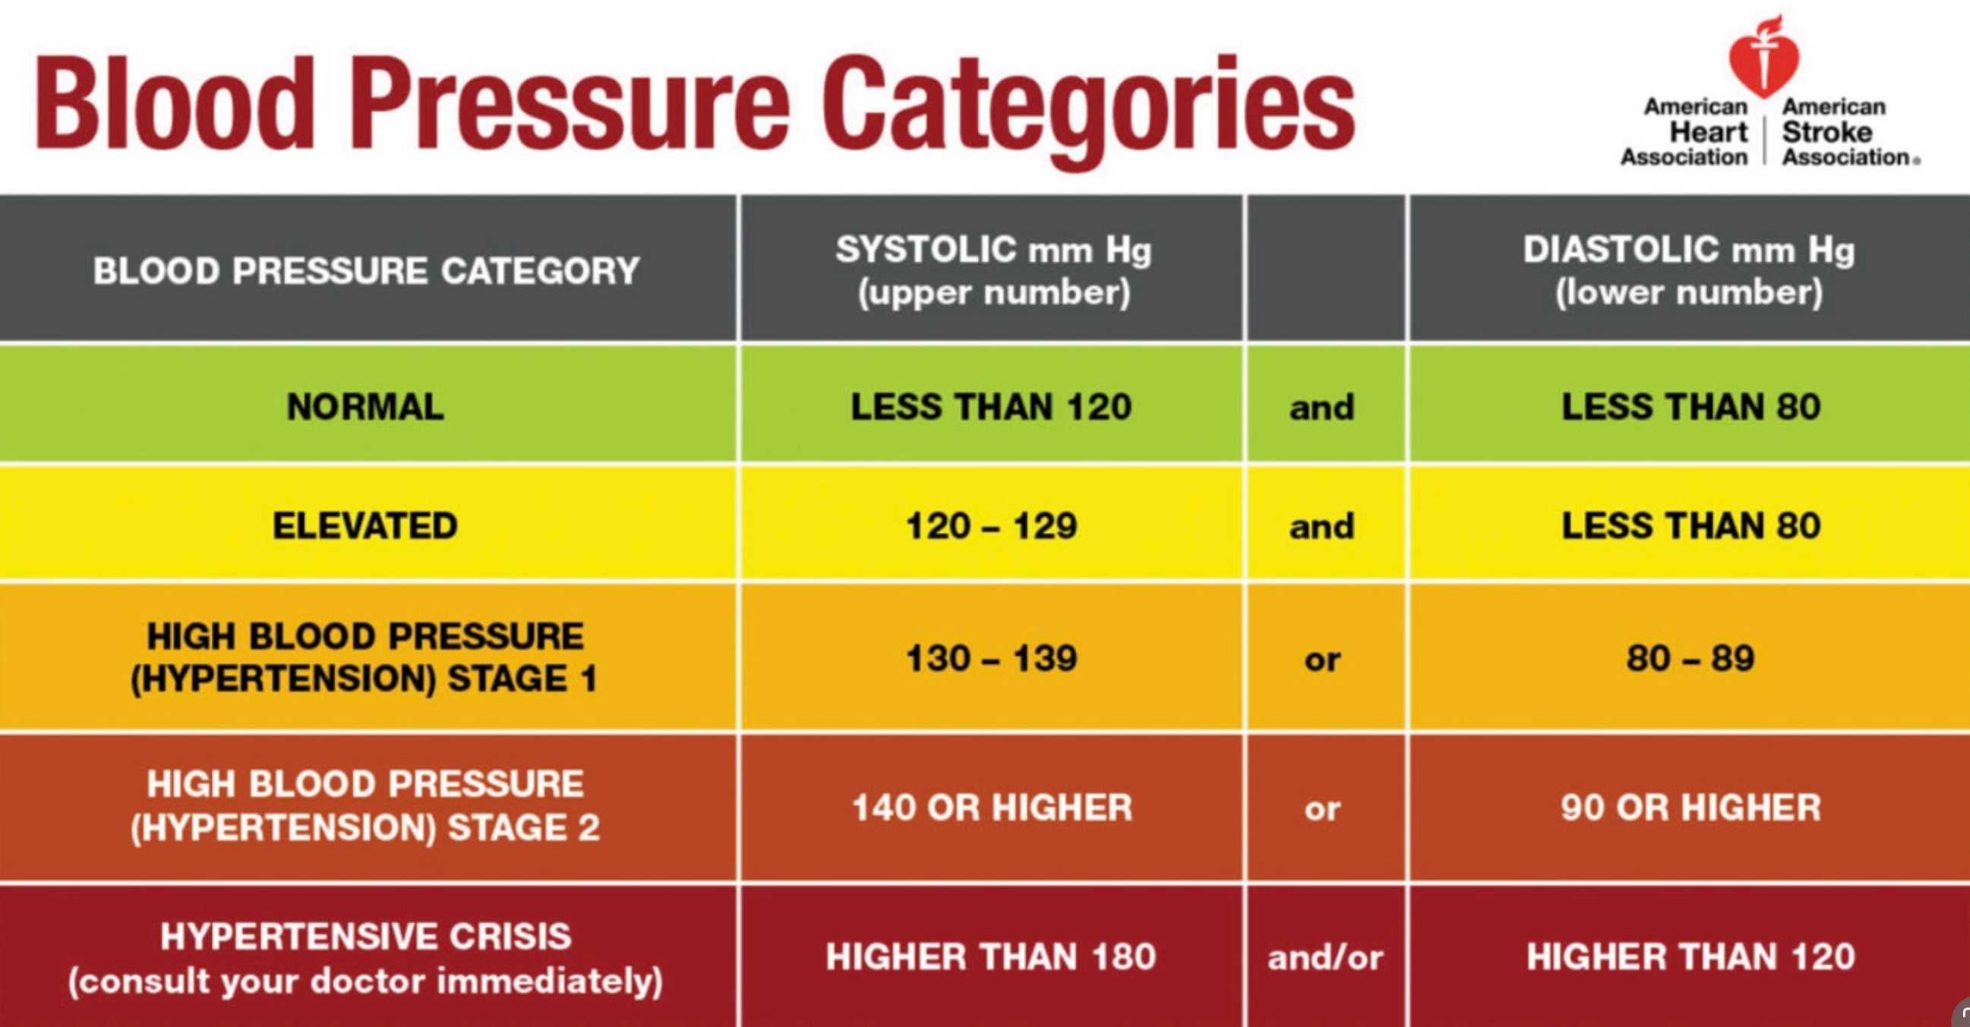

Slide 24
The medical management of HTN is largely focused on risk reduction through modifiable risk factors and pharmacological intervention. Lifestyle changes are recommended to address modifiable risk factors associated with HT.
Pharmacological agents may be used to decrease preload, dilate peripheral vessels or alter heart rate. Diuretics, beta-blockers, calcium channel blockers, and angiotensin-converting enzyme inhibitors may be used alone or in combination, depending on the pathology.
Physical therapy intervention is typically focused on risk factor modification through progressive exercise and education. A patient may also qualify for a formal cardiac rehabilitation program depending on the degree of hypertension and existence of other comorbidities.

Slide 25
Most patients are able to effectively manage HTN through risk factor modification and medication management. For patients with secondary HTN, further intervention may be necessary to treat the underlying pathology.
Morbidity and mortality are typically associated with poorly controlled HTN which increases the risk for metabolic syndrome, myocardial infarction, heart failure, cerebrovascular accident, aneurysm, cognitive changes, kidney dysfunction, and visual impairment.

Slide 26
Clinical manifestation
Hypertension is often asymptomatic, creating a significant health risk.
When symptoms are noticed they include:
a. Headache.
b. Vertigo.
c. Flushed face.
d. Blurred vision.
Increased nocturnal urinary frequency.
f. Increased B/P.

Slide 27
Myocardial infarction (heart attack)
Prolonged ischemia, injury, and death of an area of the myocardium caused by occlusion of one or more of the coronary arteries.
MI, also known as a "heart attack" or a "coronary," is the development of ischemia with resultant necrosis of myocardium. Any prolonged obstruction depriving the heart muscle of oxygen can cause an MI.
It occurs in 1.5 million persons each year and represents the leading cause of death in the adult American population.
The primary risk factors for MI include patient or family history of heart disease, smoking, physical inactivity, stress, hypertension, elevated cholesterol, diabetes mellitus, and obesity. The use of cocaine and aortic stenosis may also cause a MI. It has been documented that a MI will occur more frequently in the morning hours and during the November to December holiday season.

Slide 28
Zones of infarction.
a. Zone of infarction: consists of necrotic, noncontractile tissue; electrically inert; on ECG, see pathological Q waves.
b. Zone of injury: area immediately adjacent to central zone, tissue is noncontractile, cells under-going metabolic changes; electrically unstable ;on ECG, see elevated ST segments in leads over injured area.
c. Zone of ischemia: outer area, cells also undergoing metabolic changes, electrically unstable; on ECG, see T wave inversion.
Thrombosis of the anterior descending branch of the left coronary artery (LAD) is the most common location of infarct and affects the left ventricle (‘’widow maker’’)

Slide 29
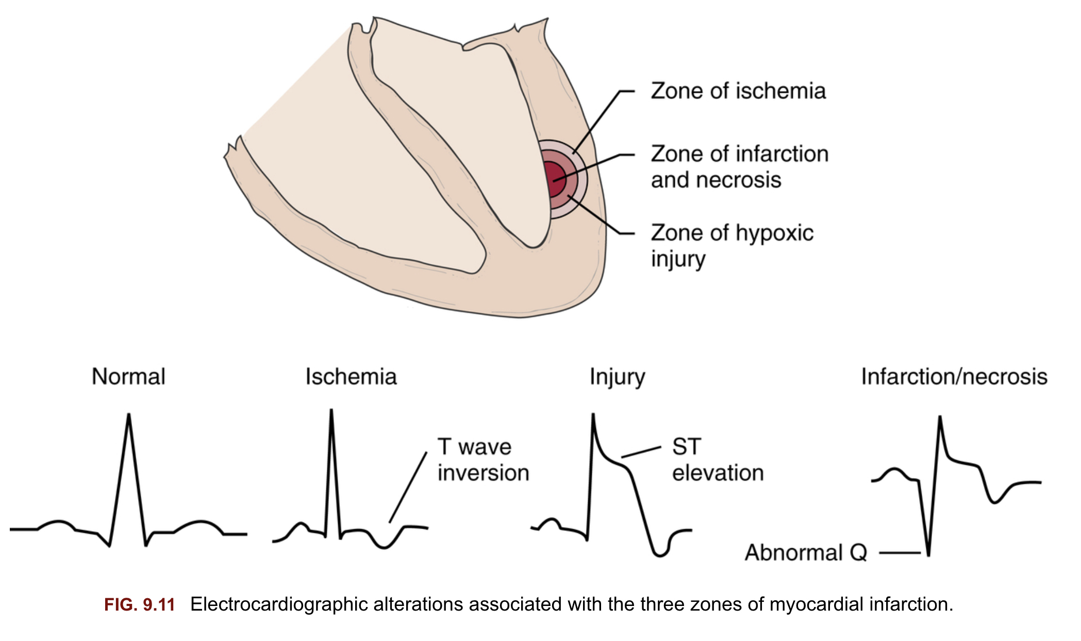

Slide 30
Infarction sites.
a. Transmural: full thickness of myocardium, which is often an ST elevated MI (STEMI) or Q wave MI (affects hearts lower chambers)
b. Nontransmural: subendocardial area (inner third of the myocardium). Non-ST elevated MI (NSTEMI) or non-Q wave MI.
Clinical presentation
Approximately 2/3 of patients experience symptoms days to weeks before the event, including unstable angina, shortness of breath, and fatigue.
A patient that is experiencing a MI will initially present with deep pain or pressure in the substernal area. The pain may or may not radiate to the jaw and down the left arm or to the back. The patient cannot alleviate the pain with rest or nitroglycerin and the pain may last for hours.
The patient is usually anxious, pale, sweating, fatigued, and may present with nausea and vomiting. Symptoms of a MI frequently do not follow a typical pattern, especially in females. There are also instances of a silent MI where no symptoms are noted.

Slide 31
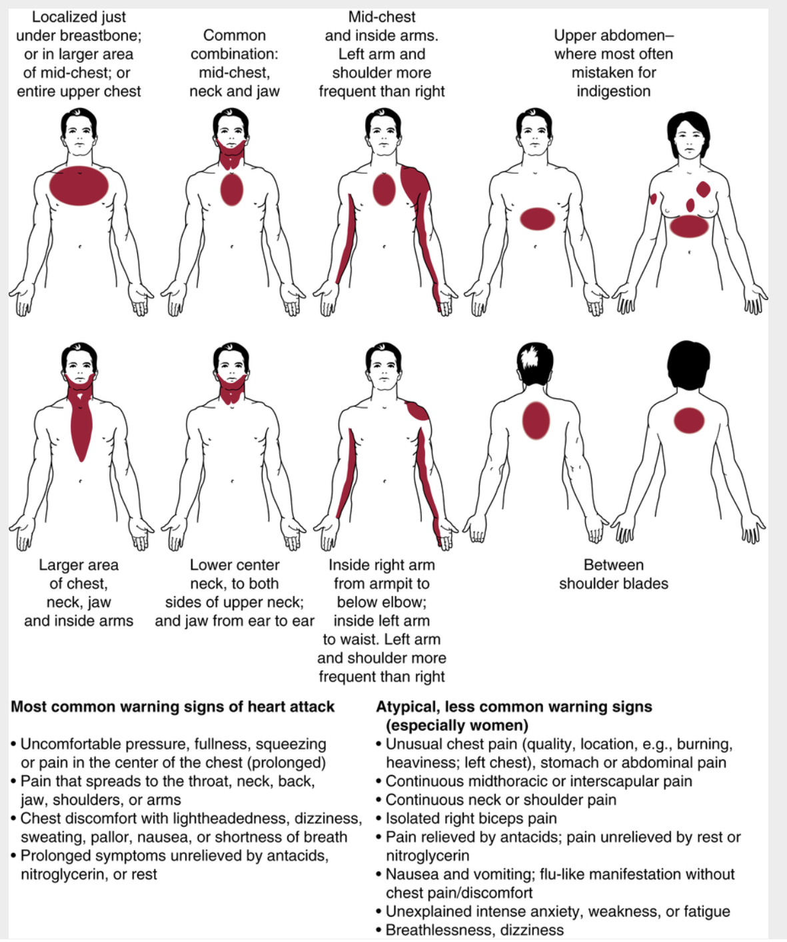

Slide 32
The primarily tool to detect a MI is a 12-lead electrocardiogram.
A blood serum analysis can be utilized to determine the level of selected cardiac enzymes. The level of selected enzymes such as creatine phosphokinase (CPK), aspartate transferase (AST), and lactic dehydrogenase (LDH) can be dramatically altered during and after a MI.
Medical management of a MI is to stabilize the patient and initiate pharmacological intervention to hinder the evolution of the MI. Anticoagulants, beta-blockers, thrombolytic agents, angiotensin-converting enzyme inhibitors, vasodilators, and estrogen (in women) may be used. Once stable, the patient is managed through a cardiac rehabilitation program.
Surgical intervention including angioplasty, stenting, endarterectomy, and bypass grafting may be indicated based on the underlying cause of the MI.

Slide 33
Exercise testing is performed within 3 days of the MI in order to establish baseline guidelines for patients that are cleared to exercise and do not exhibit any arrhythmias or angina.
Physical therapy intervention usually follows a multi-phase cardiac rehabilitation program and continues in an outpatient setting once the patient is discharged from the hospital.
Low-level therapeutic exercise, functional activities, relaxation, breathing techniques, endurance training, and continuous monitoring of vital signs are key components of this program. Patient education regarding reduction of risk factors, return to activity, and commitment to fitness and health are also important to the success of physical therapy intervention.

Slide 34
CONGESTIVE HEART FAILURE
In CHF the heart is no longer able to pump enough blood to meet the body's needs.
Two types of CHF exist:
Right and Left ventricular failure.
Left sided heart failure-true congestive heart failure (forward).Blood is not adequately pumped into systemic circulation d/t inability of L ventricle to pump. S/S: pulmonary edema, cough, dyspnea, orthopnea, fatigue, tachycardia (circulatory congestion)
Right sided heart failure (reverse). Blood is not adequately returned from the system. S/S: Peripheral edema (pitted edema), ascites (abdominal edema), weight gain, cyanosis, vinous distension.

Slide 35
Etiology. Causes of CHF include a previous myocardial infarction, heart valve incompetence, hypertension over a prolonged period, or very low or very high heart rate. It is not an independent disease process but rather than a symptom of pathology within the heart muscle itself or cardiac valves. Arrhythmia (atrial fibrillation), pulmonary embolism, HTN, unstable angina, renal failure, high salt intake, severe anemia may lead to CHF.
A patient with CHF will initially show signs of tachycardia.
Other signs include venous congestion, high catecholamine levels (important in stress responses), and finally impaired cardiac output.
As the severity of CHF increases, signs of venous congestion usually become apparent.

Slide 36
Left-sided heart failure is generally associated with signs of pulmonary venous congestion, edema, and low cardiac output d/t backup of blood from L ventricle to the L atrium and lungs. Failure of the left ventricle prevents the heart from pumping enough blood through the arterial system to meet the body's metabolic needs and causes either pulmonary edema or a disturbance in the respiratory control mechanisms.
Right-sided heart failure is associated with signs of systemic venous congestion; Failure of the right ventricle to adequately pump blood to the lungs results in peripheral edema and venous congestion of the organs. Symptoms result from congestion in the heart's right side and throughout the venous system.
Impairment to either ventricle can affect the other, leading to both systemic and pulmonary venous congestion. A patient may present with pulmonary edema, nocturnal dyspnea, orthopnea (discomfort when breathing while lying down flat), S3 gallop, dry cough, exertional dyspnea with low level exercise, sudden weight gain, possible cyanotic extremities, cardiac hypertrophy, and shortness of breath.
https://youtu.be/mhYeO2fwSps

Slide 37
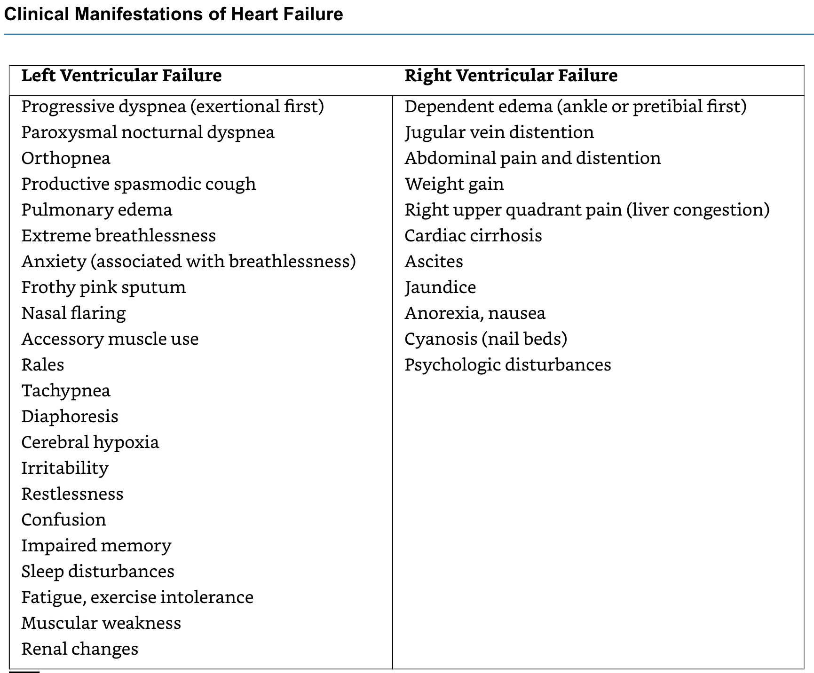

Slide 38
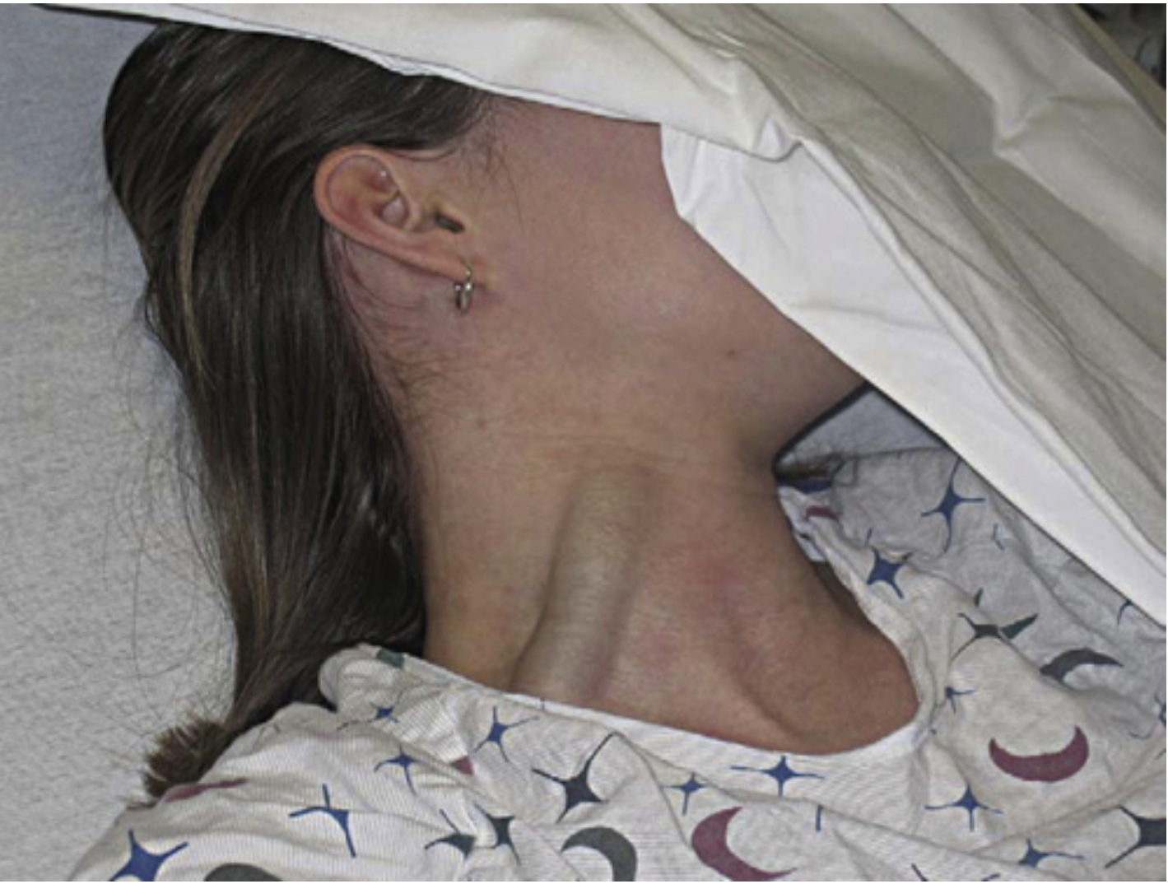
Jugular venous distention also results from fluid overload. The jugular veins empty unoxygenated blood directly into the superior vena cava. Because no cardiac valve exists to separate the superior vena cava from the right atrium, the jugular veins give information about activity on the right side of the heart.

Slide 39
Lab tests including urinalysis and a CBC count that includes electrolyte, thyroid stimulating hormone, blood urea nitrogen (BUN), and serum creatinine levels should be performed.
A chest x-ray, electrocardiogram, and echocardiogram are also recommended. A Doppler echocardiogram can determine systolic and diastolic performance, the cardiac output (ejection fraction),and pulmonary artery and ventricular filling pressures.
Medical management includes the use of diuretics, nitrates, cardiac glycosides, analgesics, and angiotensin-converting enzyme inhibitor agents.
Therapists must be aware of the potential side effects such as digitalis toxicity when treating this population. Signs of toxicity: nausea, vomiting, and an irregular heartbeat.
Therapeutic intervention has to be individualized by each patient since the etiology, current medications, and overall health play a role in the plan of care. Walking is commonly used to initiate an exercise program with cardiac patients. Patients can progress their overall endurance following their own heart rate and perceived exertion guidelines.

Slide 40
The prognosis for CHF is poor. Despite the heart's compensatory mechanisms, the ability of the heart to contract and relax progressively worsens and eventually fails. End-stage CHF without pharmaceutical or surgical intervention (e.g., transplantation) will result in death.

Slide 41
PULMONARY EDEMA
Pulmonary edema is a condition characterized by excess fluid within the lungs.
Occurs when the left ventricle is unable to adequately pump blood to the systemic circulation (e.g., left-sided heart failure).
Causes fluid to back up into the pulmonary circulation and the lungs. Other causes of fluid buildup within the lungs include living at high elevations, respiratory distress syndrome, pulmonary embolism, adverse drug reactions, viral infections, smoke inhalation, and exposure to toxins.
Acute pulmonary edema is considered a medical emergency.

Slide 42
When the left ventricle is unable to adequately pump blood to the systemic circulation, fluid backs up into the left atrium and then into the pulmonary circulation. As the pressure in the pulmonary circulation increases, the fluid moves from the lung capillaries into the alveoli, which makes breathing more difficult.
Acute pulmonary edema is characterized by extreme shortness of breath (especially when lying down), wheezing or gasping, anxiety, a cough that produces frothy sputum (may be tinged with blood), chest pain, and palpitations.
Chronic pulmonary edema is characterized by shortness of breath that worsens when lying down or during physical activity, wheezing, weight gain, lower extremity swelling, and fatigue.
Chest x-ray is used to confirm the presence of fluid within the lungs.

Slide 43
CARDIOMYOPATHY
Cardiomyopathy is not one disease but a group of diseases affecting the heart, all of which are serious and can lead to the need for heart replacement surgery. When the heart muscle or myocardium is damaged, it may hypertrophy or dilate.
Etiology. The causes include heart attacks; alcoholism; long-term, severe hypertension; systemic lupus erythematosus (SLE); end-stage renal disease; and viral infections.
In dilated cardiomyopathy, the heart muscle is thinner than usual.
In hypertrophic cardiomyopathy, there is thickening of the myocardium, particularly in the left ventricle.
In restrictive cardiomyopathy, the heart is unable to expand because of deposition of fibrous tissue.

Slide 44
Signs and symptoms include dyspnea, cough, heart palpitations (awareness of a loudly beating heart), lower extremity dependent edema or just edema (dependent edema occurs when the legs are hanging down), ascites (abdominal edema), angina chest pain, dizziness and light-headedness, low daily urine output, changes in mental alertness, appetite loss, and general deconditioning.
The outcome for this condition depends on the cause and severity of the disease and whether it responds to drug therapy.
Cardiomyopathy is a serious, chronic problem and can get progressively worse. Serious complications of the disease include heart failure and arrhythmia.

Slide 45
Peripheral vascular disease
Peripheral vascular disease (PVD) is a condition where there has been narrowing of the lumen of blood vessels causing a reduction in circulation usually secondary to atherosclerosis.
This can be compounded by either emboli (blood clot that carried in the bloodstream) or thrombi (blood clot adhered to vessel wall).
PVD, also known as arteriosclerosis obliterans, is primarily the result of atherosclerosis. Damage can occur to the walls of both arteries and veins from fatty plaque buildup that creates hard and narrow vessels. The atherosclerotic process will gradually progress to significant or complete occlusion of medium and large arteries.

Slide 46
Contributing factors:
Atherosclerosis (primary factor)
phlebitis,
injury or surgery,
autoimmune disease,
diabetes mellitus,
smoking,
hyperlipidemia,
inactivity,
hypertension,
positive family history
increased age,
obesity

Slide 47
Symptoms and clinical presentation
During the early stages of PVD intermittent claudication may be the only manifestation. Symptoms are normally relieved by rest. Claudication also may present as buckling or "giving out" of the lower extremity after a certain period of exertion and may not demonstrate the typical symptom of pain on exertion.
Other symptoms:
tingling and numbness of the affected extremities,
pain at rest and during sleep,
slowed healing,
changes in skin coloring: pale on elevation, dusky red on dependency
decrease in skin temperature,
absence of hair on the extremity
decreased or absent pulse.

Slide 48
Routine blood tests generally are indicated and include CBC, BUN, electrolytes studies. Doppler ultrasound studies are used to determine flow status. MRI, angiogram or arteriogram can also be used to assist with the diagnosis.
The ankle-brachial index (ABI) can be used to provide a ratio of systolic blood pressure of the lower extremity compared to the upper extremity. A rubor of dependency test, transcutaneous oximetry, and treadmill exercise test may also assist with baseline information and diagnosis of insufficiency.
Systolic blood pressures are measured in both brachial arteries and both tibialis posterior arteries with a sphygmomanometer and a handheld Doppler ultrasound device.

Slide 49
Pharmacological intervention: anticoagulants such as heparin, antiplatelet agents and thrombolytics may be indicated.
Patient education is paramount regarding the disease process, limb protection, foot and skin care, and risk factor reduction (smoking cessation, avoid cold exposure).
Physical therapy. A walking program will initially have the patient walk until near maximal pain and then rest until the pain is relieved. The goal is to have the patient achieve longer walking periods with less rest, eventually walking for 30 minutes continuously.
After 4-6 weeks of therapy include isometric and active range exercises, implementation of resistive exercise.
In more severe cases, surgical intervention may be required. Common procedures include balloon angioplasty, stent implantation or bypass surgery.

Slide 50
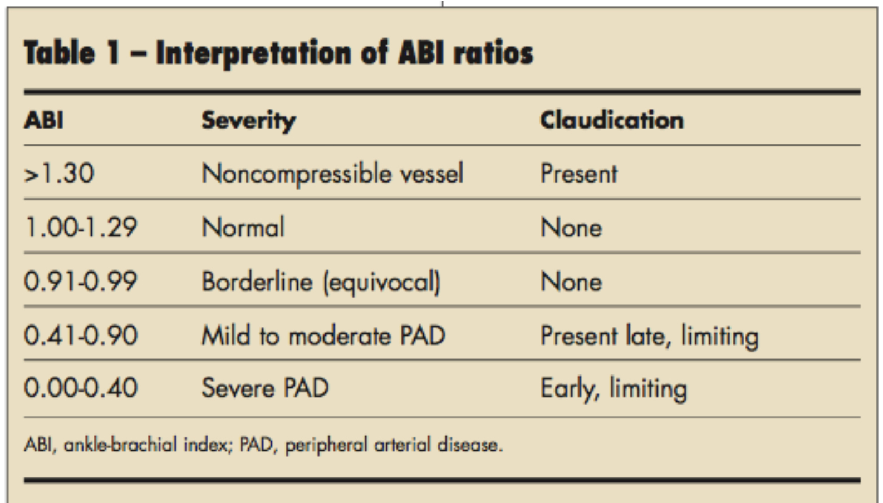
ABI (Ankle-Brachial index)
The ABI is calculated by dividing the higher of the two blood pressure measurements in the ankles by the higher of the two systolic blood pressure measurements at the arms.

Slide 51
Patients with PVD are at a higher risk overall for complications such as permanent numbness, tingling or weakness in lower extremities and/or feet, permanent sensory changes such as burning or aching pain, gangrene, and amputation of the affected body part.
Patients with PVD are also at higher risk of heart attack and stroke. Symptomatic PVD has at least a 30% risk of death within five years and approximately 50% in ten years, secondary to MI or cerebrovascular disease.

Slide 52
Thromboangiitis Obliterans (Buerger's Disease)
1. Chronic, inflammatory vascular occlusive disease of small arteries and also veins. Affects the arteries and veins of the upper and lower extremities especially of the hands and feet.
2. Occurs commonly in young adults, largely males, who smoke.
3. Begins distally and progresses proximally in both upper and lower extremities.
4. Patients exhibit paresthesias or pain, cyanotic cold extremities, diminished temperature sensation, fatigue, risk of ulceration and gangrene.

Slide 53
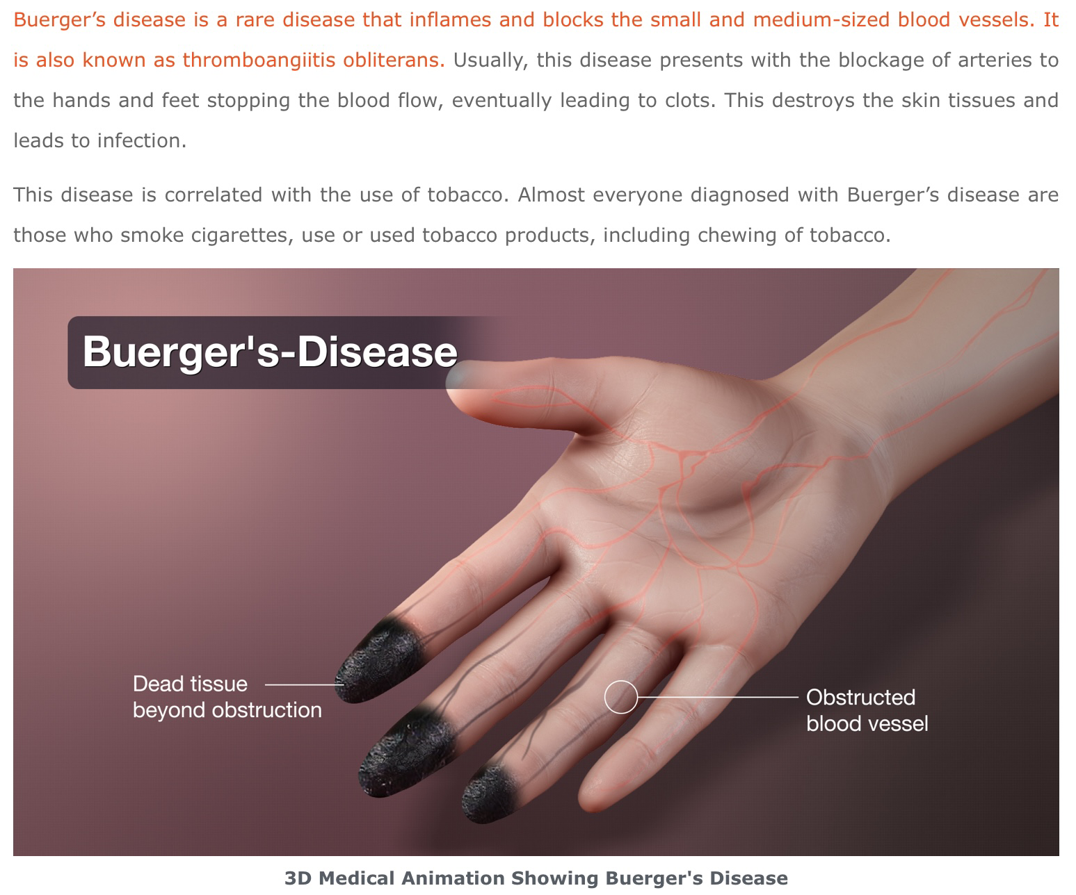
Notes:
Autoamputation

Slide 54
DIABETIC ANGIOPATHY
Happens d/t inappropriate elevation of blood glucose levels and accelerated atherosclerosis.
Neuropathy is a major problem.
Neurotrophic ulcers, may lead to gangrene and amputation.
Diabetic ulcers are a combination of arterial and neuropathic problems. The patient with diabetes may have a peripheral neuropathy, creating loss of sensation in the affected limb. This means that diabetic ulcers will not be painful, but they are difficult to treat because the circulation to the area is impaired and healing is slow. A typical diabetic ulcer is located on the plantar surface of the foot.

Slide 55
Raynaud's Disease or Syndrome
Raynaud's disease and phenomenon affects women more than men and is common in women between ages 20 and 49. Raynaud's can be classified as a peripheral vascular disease because it affects the blood vessels.
Etiology. Raynaud's is particularly common in people with connective tissue diseases such as scleroderma, rheumatoid arthritis, and systemic sclerosis, but in many cases, there is no known etiology. A genetic component to the disease may exist, and it has been found that Raynaud's is often a precursor to the development of connective tissue disease.

Slide 56
People with Raynaud's disease or syndrome are acutely sensitive to cold. Onset of symptoms can also be brought on by emotional stress, smoking, and "working with vibrating machinery.“
Symptoms: paleness of the skin, especially of the hands, and reduction of skin temperature.
Raynaud's disease and Raynaud's phenomenon are not usually serious, but the patient cannot tolerate exposure to the cold.
Medical intervention is aimed at reducing the number of attacks of the condition, and preventing vascular damage and ulceration of the fingers, which may occur with vascular damage. Calcium channel blockers may be prescribed for improved vascular health.
Physical Therapy Intervention. The PT and PTA should not apply cold packs to patients with either the disease or the phenomenon because of the severe reaction to cold. In addition, aquatic therapy may not be possible unless the pool is heated to at least body temperature. The use of whirlpool treatments with the water at nonthermal temperatures should also be avoided.

Slide 57
DEEP VEIN THROMBOSIS and THROMBOPHLEBITIS
Thrombophlebitis means inflammation and clotting of veins.
Venous thrombosis is a condition characterized by the formation of the blood clot (thrombus) within the vein.
The condition usually affects either the deep or superficial veins of the lower extremities.
Risk factors include prolonged immobility, recent surgery, pregnancy, obesity, cigarette smoking, medications (e.g., birth control, hormone replacement), blood conditions characterized by "thick" blood (e.g., polycythemia-increase in the number of red blood cells in the body),blood-clotting disorders, cancer, and certain autoimmune disorders.

Slide 58
Signs and Symptoms. The signs and symptoms may include generalized fever, tenderness, and erythema (redness) over the area of the vein, induration (hardening of the tissue), and possible pain and tightness of the area.
Watch for SWELLING, REDNESS, WARMTH, PAIN.
Signs of deep venous thrombosis (DVT) in the popliteal vessels of the lower leg can include pain in the central posterior calf, sometimes with swelling, acute tenderness to touch, and possible fever.
Homan’s sign is characterized by pain in the calf when the foot is passively or actively dorsiflexed, but it is not a reliable test for DVT (has low sensitivity and specificity)

Slide 59
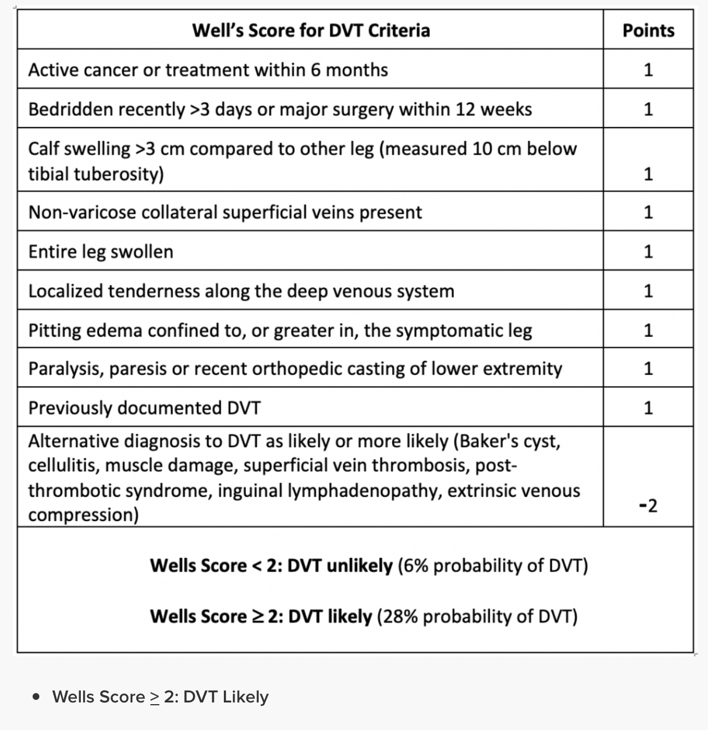
Standardized risk assessment measure: use Wells Criteria Score for DVT

Slide 60
Medical Intervention. Doppler ultrasound studies of the vessels to detect potential blockages. Because of the danger of loosening the thrombus in the vein and creating an embolus, the patient is required to have bed rest. A compression bandage may be used and the patient placed on anticoagulant medications.
Complications of a DVT are an embolus that could lodge in the lungs and cause death. Some individuals appear to be prone to the condition and are advised to wear elastic stockings and do exercises and activity after prolonged periods of rest. The use of compression pumps during periods of immobility is helpful in reducing the risks of DVT.
Physical Therapy Intervention. The PT and PTA are involved with ambulating and exercising patients early after surgery to reduce the risk of developing DVT. The PTA should be careful to note any lower extremity pain, particularly in post surgical patients. In some cases, there will not be any warning signs until the patient has a pulmonary embolus with chest pain. Occasionally, there may be sudden onset of extreme pain in the area of the hip. Any unusual sign noted by the PTA should be taken seriously.

Slide 61
PULMONARY EMBOLISM
Embolism that blocks a pulmonary artery is referred to as a pulmonary embolism (PE).
A PE occurs as a result of venous thrombi that have detached and traveled from elsewhere in the body before lodging in a pulmonary artery. In most cases, multiple thrombi must be present to create a blockage large enough to produce PE symptoms.
PE will cause decreased perfusion (passage of fluid through the circulatory system) in the lung tissue supplied by blocked vessel. The tissue becomes ischemic and fails to provide adequate oxygen for the body.

Slide 62
Signs and symptoms of PE include a sudden onset of dyspnea, coughing, hypoxia, and chest pain which may mimic myocardial infarction.
Dyspnea presents both at rest and with activity. Complaints of chest pain typically worsen with coughing, eating, deep breathing or bending activities. Coughing may produce blood tinged sputum. Other signs and symptoms may include unilateral LE edema, cyanosis, wheezing, diaphoresis, fainting, with a rapid or weak pulse.
V-Q ventilation-perfusion scan and CT scan can be used to confirm diagnoses.

Slide 63
CHRONIC VENOUS INSUFFICIENCY
Chronic venous insufficiency (CVI) typically affects the distal lower extremities and is characterized by venous incompetence and resultant venous hypertension. VI increases fluid volume within interstitial spaces, eventually overloading the lymphatic system resulting in edema.
The accumulation of protein-rich fluid causes local inflammation, hypoxia, and fibrotic changes within the tissues. These changes are significant factors in the development of venous stasis ulcers and delayed healing.

Slide 64
Symptoms include edema, feelings of heaviness, and dull, aching pain in the distal lower extremities.
Symptoms generally improve and may resolve fully with elevation, however, they reappear once dependent positioning is resumed.
Untreated venous hypertension and stasis related symptoms will cause a brawny skin discoloration and hyperkeratosis. Chronic inflammation can lead to poor wound healing and fibrotic changes in the subcutaneous tissue.
Medical management: venous ultrasonography to visualize structures.
Notes:
Hemosiderin

Slide 65
Chronic Arterial insufficiency vs Chronic Venous insufficiency
Chronic Arterial insufficiency:
Etiology: Atherosclerosis Thrombosis, Emboli, Inflammatory process.
S/S: severe muscle ischemia, intermittent claudication; worse with exercise, relieved by rest, rest pain indicates severe involvement; muscle fatigue, cramping, numbness.
Location of pain: calf, lower leg, dorsum of foot, may occur in hip or glute.
Vascular: Decreased or absent pulses, pallor foot on elevation, dependent rubor.
Skin changes: pale, shiny, dry skin, loss of hair, nail changes, coolness of extremity.
Ulceration: may develop in feet, toes, or areas of traumas, pale or yellow to black eschar, gangrene may develop; regular in shape and may appear punched out.

Slide 66
Chronic Venous insufficiency:
Etiology:thrombophlebitis, trauma, vein obstruction (clot), vein incompetence.
S/S: Min-mod pain, aching pain in lower leg with prolonged standing or sitting (dependency)
Location of pain: superficial pain along the course of vein.
Vascular: Venous dilation. Mod to severe edema, especially after prolonged dependency.
Skin changes: Hemosiderin (red blood cells are broken down) deposition: dark, cyanotic, thickened brown skin. May lead to dermatitis, cellulitis (bacterial skin infection).
Ulceration: may develop in ankles, especially medial malleolus, no gangrene, painful, shallow, exudative, irregular borders.

Slide 67
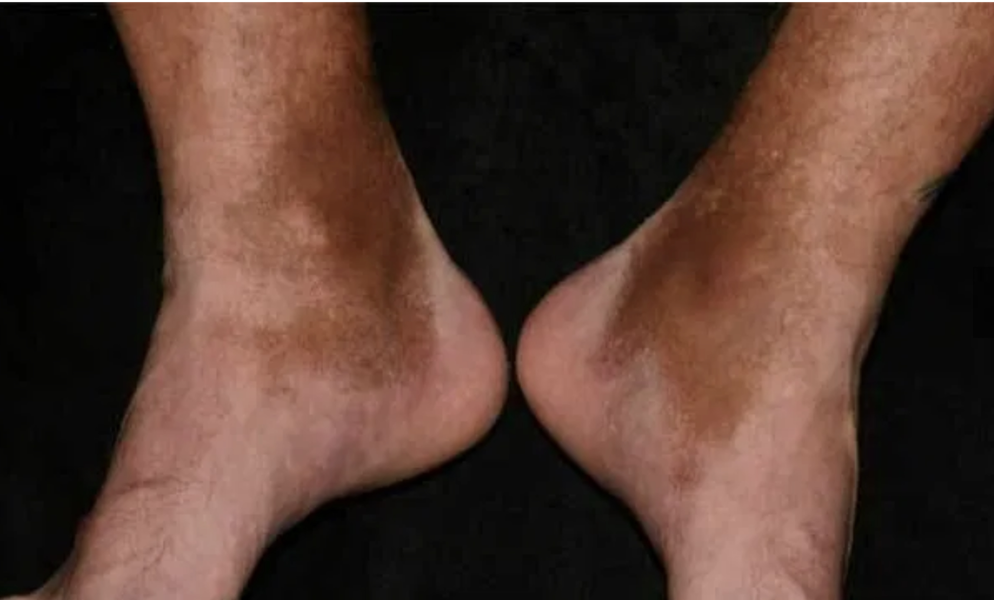
Hemosiderin depositions

Slide 68
COR PULMONALE
Cor Pulmonale, also called pulmonary heart disease, is the enlargement of the R ventricle secondary to pulmonary hypertension (high blood pressure in pulmonary arteries) that occurs in diseases of the thorax, lung, and pulmonary circulation. It is a term that describes the pathologic effects of lung dysfunction as it affects the right side of the heart.
Chronic cor pulmonale occurs most frequently in adult male smokers, although the incidence in women is increasing as heavy smoking in females becomes more prevalent.
The actual prevalence of cor pulmonale is difficult to determine because cor pulmonale does not occur in all cases of chronic lung disease and because routine physical examination and laboratory tests are relatively insensitive to the presence of pulmonary hypotension. It has been estimated that cor pulmonale accounts for 5% to 10% of organic heart disease.

Slide 69
Pulmonary vascular diseases and respiratory diseases (emphysema, chronic bronchitis) are the primary causes of cor pulmonale.
Normally the ventricle is a thin-walled (heart) muscle able to meet an increase in volume and pressure, but long-term pressure overload from hypertension causes the tissue to hypertrophy.
Evidence of cor pulmonale may be obscured by primary respiratory disease and may appear only during exercise testing.
The heart appears normal at rest, but with exercise, cardiac output falls and the ECG shows right ventricular hypertrophy.
The predominant symptoms are related to the pulmonary disorder and include chronic productive cough, exertional dyspnea, wheezing respirations, easy fatigability, and weakness.

Slide 70
Diagnosis is made on the basis of physical examination, x-ray, and ECG or echocardiogram. Pulmonary function tests usually confirm the underlying lung disease. Laboratory findings may include polycythemia present in cor pulmonale secondary to COPD. ECG and chest film may not be diagnostic in the early stages of cor pulmonale.
Treatment. The primary goal of medical treatment is to reduce the workload of the right ventricle. This is accomplished by lowering pulmonary artery pressure. Oxygen administration, salt and fluid restriction, and diuretics are essential, as well as treatment of the underlying chronic pulmonary disease, while at the same time relieving the hypoxemia, hypercapnia, or acidosis. There is no specific surgical treatment available for most causes of chronic cor pulmonale. Heart-lung transplantation for clients with PH is valuable in late-stage disease.

Slide 71
Prognosis. Because cor pulmonale generally occurs late during the course of COPD and other irreversible disease, the prognosis is poor. Once congestive signs appear, the average life expectancy is 2 to 5 years, but survival is significantly longer when uncomplicated emphysema is the cause. Although cor pulmonale can be caused by obstructive and restrictive lung diseases, restrictive lung diseases are associated with a lower life expectancy once they reach the stage of cor pulmonale.
People who are bedridden must be repositioned frequently to prevent atelectasis (complete or partial collapse of the entire lung or area (lobe) of the lung) and skin breakdown.

Slide 72
Breathing exercises should be carried out frequently throughout the day. Diaphragmatic and pursed-lip breathing exercises should be reviewed for anyone with COPD and used with appropriate individuals. Teach the client (or family member) how to detect edema in the lower extremities, especially the ankles, by pressing the skin over the shins for 1 to 2 seconds and looking for a lasting finger impression.
Watch for signs of digitalis toxicity such as complaints of anorexia, nausea, vomiting, or yellow halos around visual images.

Slide 73


